Slide 1
British Airways
Predictive Customer buying behaviour

Slide 2
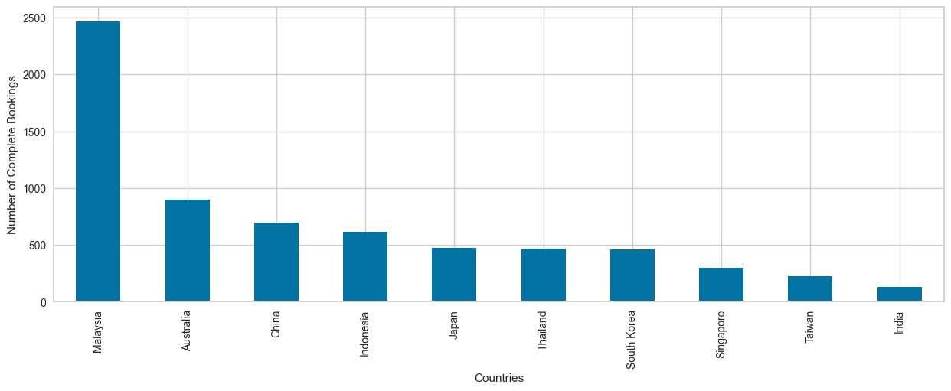
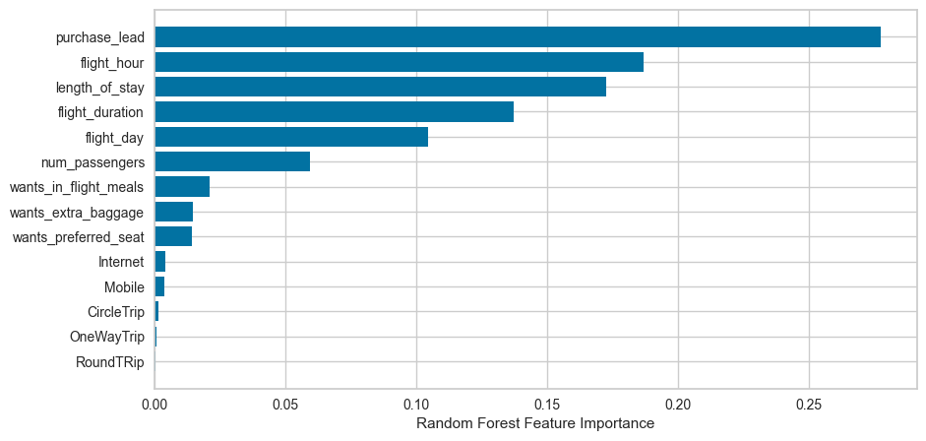
PREDICTIVE MODELLING RESULTS
Precision : 52% (of all successful complete bookings only 52% will be predicted as correct)
Accuracy : 85% (the model predicting successful or incomplete bookings)
Maximum number of complete bookings were from Malaysia followed by Australia and China.
🠊 shows the top features contributing to successful flight bookings.

